Slide 1
Drowsiness Detection

Slide 2
Content Table
01
01
04
Objective
Use Case
02
05
Introduction
Model / Deployment
03
06
Architecture
Outputs

Slide 3
Objective
01
A module for Advanced Driver Assistance System (ADAS) is presented to reduce the number
of accidents due to drivers fatigue and hence increase the transportation safety; this system
deals with automatic driver drowsiness detection based on visual information and Artificial Intelligence.

Slide 4
Introduction
02
Detecting and addressing driver fatigue in real-time is crucial for accident prevention. The Driver Drowsiness Alert System plays a vital role in identifying early signs of drowsiness, allowing for timely intervention and averting potential disasters.
The system employs computer vision, image processing, and machine learning algorithms to monitor driver behavior. By analyzing facial expressions, eye movements, and other cues, it accurately determines if a driver is showing signs of fatigue. Upon detection, the system triggers an alert to notify the driver, prompting them to take necessary precautions or rest.
Implementing a Driver Drowsiness Alert System has the potential to save lives and prevent accidents. By proactively monitoring driver fatigue, it prevents hazardous situations on the road, ensuring safety for drivers, passengers, and pedestrians.
Future advancements can further refine the Driver Drowsiness Alert System. Integration with advanced driver assistance systems and vehicle-to-infrastructure communication can provide a comprehensive approach to road safety. Ongoing research and development can improve accuracy, expand functionalities, and incorporate additional parameters for drowsiness detection, ensuring continuous improvements in accident prevention.

Slide 5
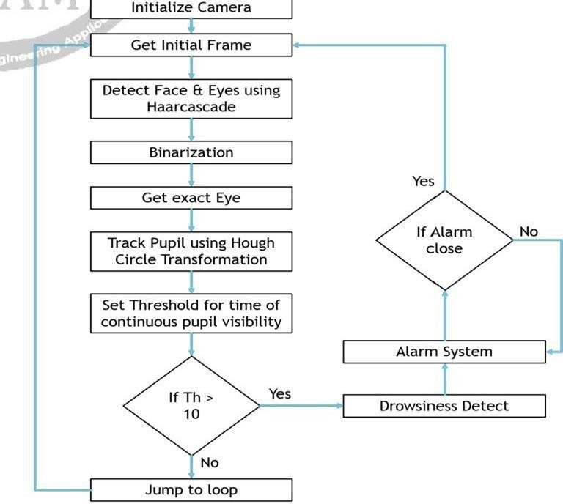
Architecture
03
The model we used is built with Keras using Convolutional Neural Networks
(CNN). A convolutional neural network is a special type of deep neural network
which performs extremely well for image classification purposes. A CNN
basically consists of an input layer, an output layer and a hidden layer which can
have multiple layers. A convolution operation is performed on these layers using
a filter that performs 2D matrix multiplication on the layer and filter.

Slide 6
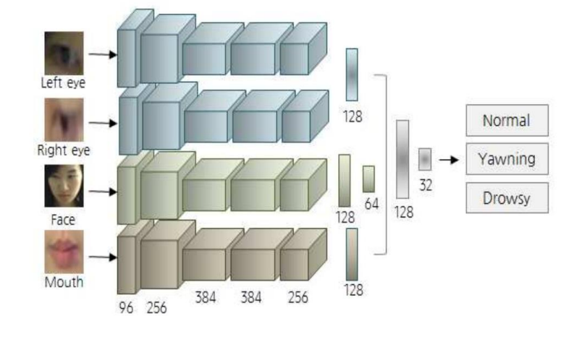
The CNN model architecture consists of the following layers:
Convolutional layer; 32 nodes, kernel size 3
Convolutional layer; 32 nodes, kernel size 3
Convolutional layer; 64 nodes, kernel size 3
Fully connected layer; 128 nodes
The final layer is also a fully connected layer with 2 nodes. A Relu activation function is used in all the layers except the output layer in which we used Softmax.

Slide 7
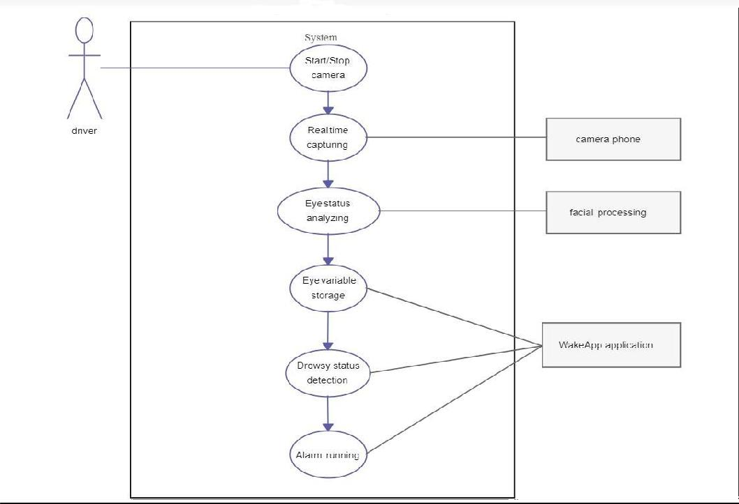
Use Cases Diagram
04

Slide 8
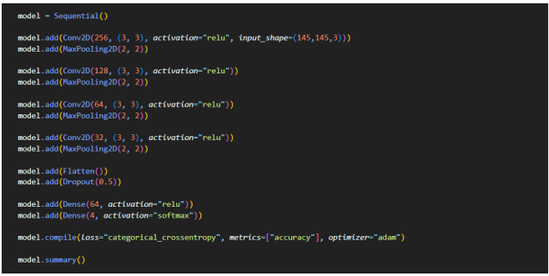
Model / Deployment
05

Slide 9
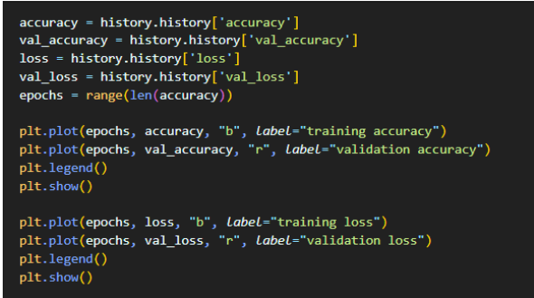
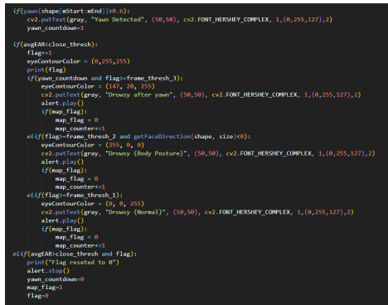

Slide 10



Outputs
06
Drowsy Yawn Normal
Drowsy Yawn Normal

Slide 11
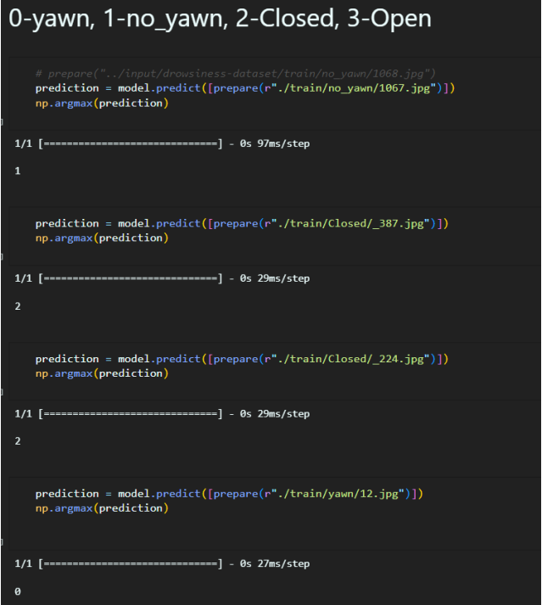
Prediction

Slide 12
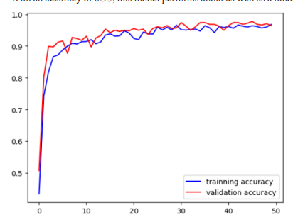
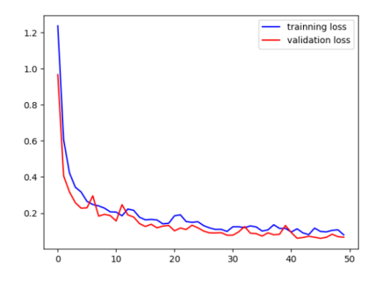
Result
Accuracy : 0.95

